Slide 1



Open Educational Resources on Cultural Risks in Multi-Cultural Organisations
Multiplier event
22.04.2021

Slide 2


















MINIGAMING
Original image from: eLearning Industry
Representing smaller chunks of learning objects
as mini-game or interactive activities
Notes:
Original definition of minigames: A minigame is a short video game often contained within another video game, and sometimes in application software or on a display of any form of hardware. A minigame contains different gameplay elements than the main game, may be optional, and is often smaller or more simplistic than the game in which it is contained

Slide 3
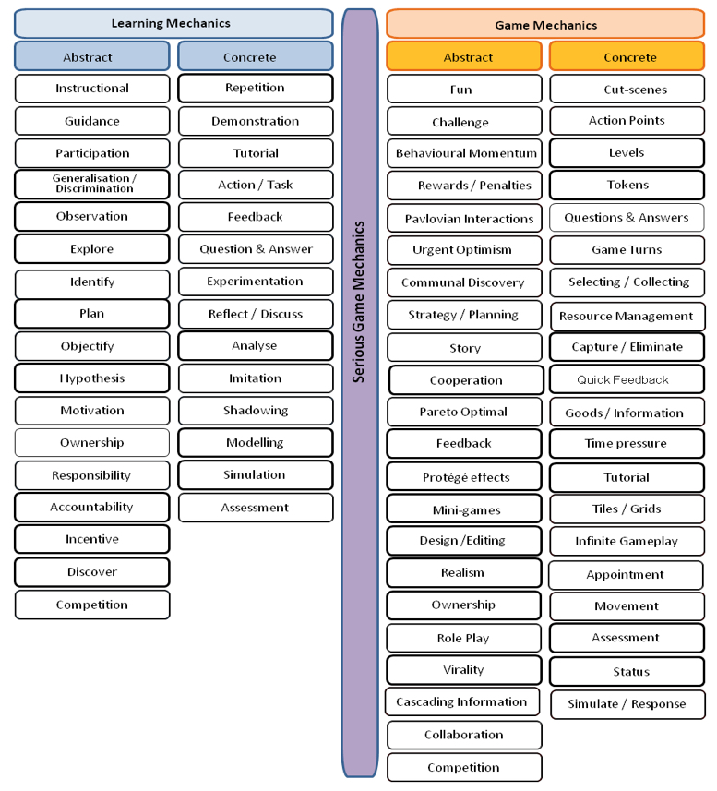
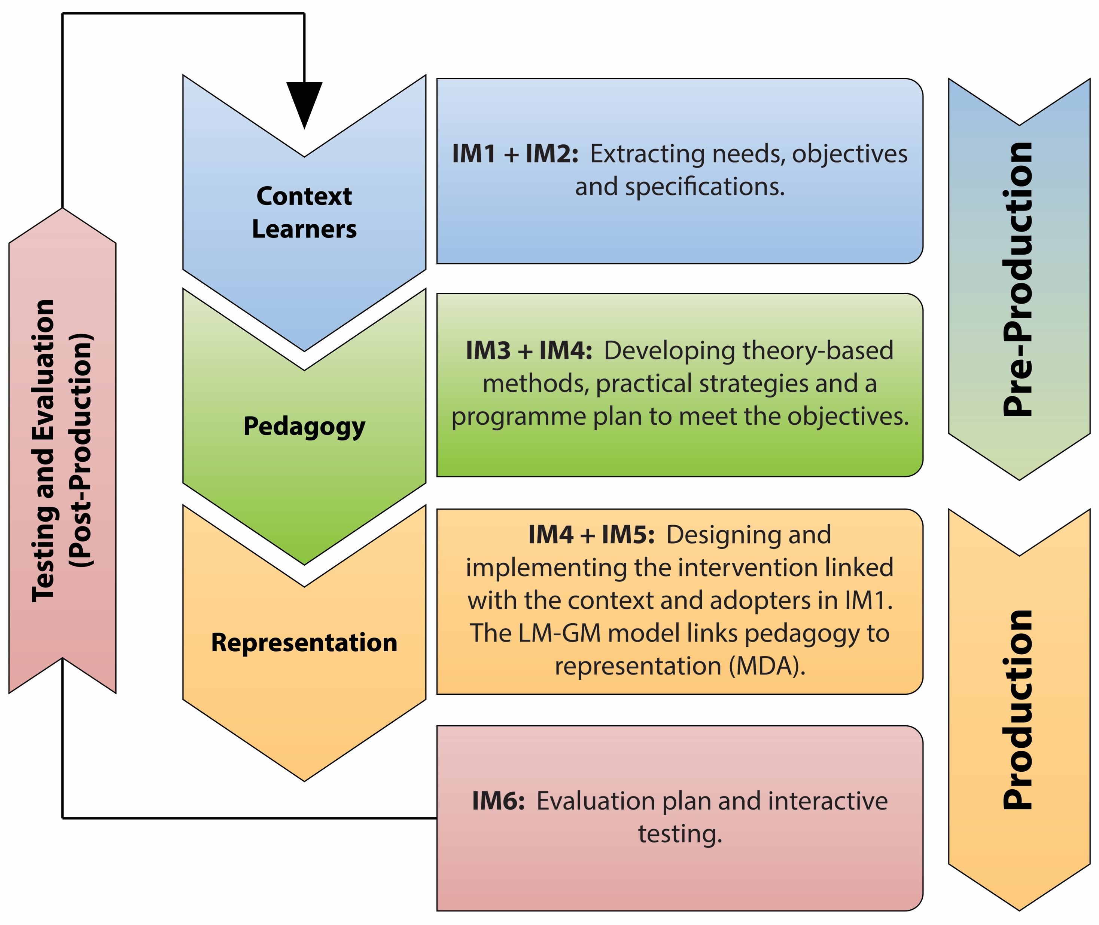
LM-GM Mapping
Learning meets games
Arnab, S. and Clarke, S. (2017), Towards a trans-disciplinary methodology for a game-based intervention development process. British Journal of Educational Technology, 48: 279–312. doi:10.1111/bjet.12377

Slide 4
Context
http://culturalrisk.eu @Cult_Risk
Notes:
5 Countries:
UK
Poland
Italy
Latvia
Cyprus

Slide 5


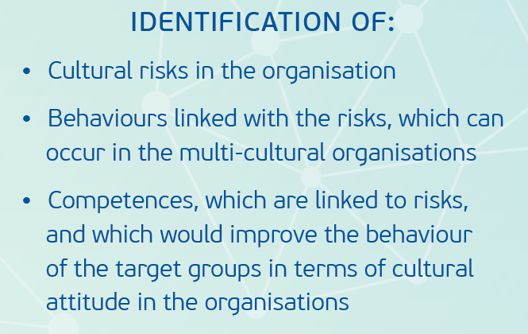


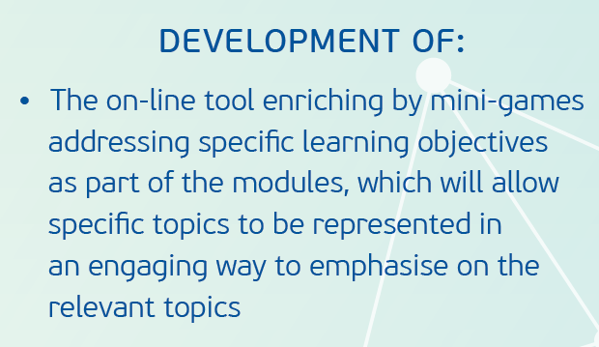
Process
Literature review of country specific focus
Consultation with managers and employees (154 participants)
Identification of main topics

Slide 6
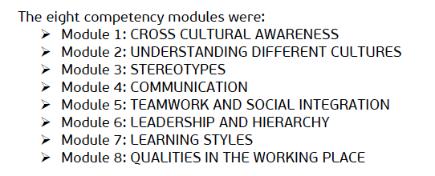
Identified 8 key topics
http://culturalrisk.eu/outcomes/

Slide 7
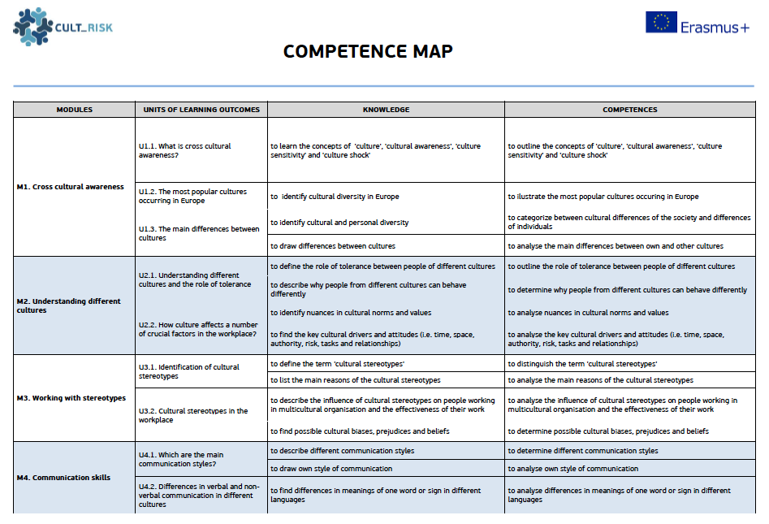
Map them against competencies…

Slide 8
Modules and Units
https://culturalrisk-course.com/

Slide 9
DEMO session: The training Platform
https://culturalrisk-course.com/

Slide 10
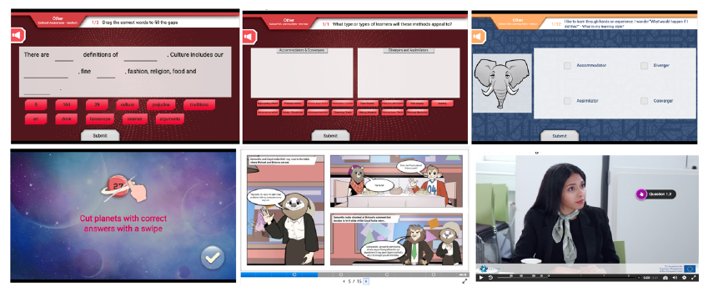
Mini-games to complement the units
Mini-game types (left to right, top down): drag-and-drop (fill in the blank), drag-and-drop (word
cluster), MCQ quiz, animated target-and-swipe, comic book, and video scenario.

Slide 11
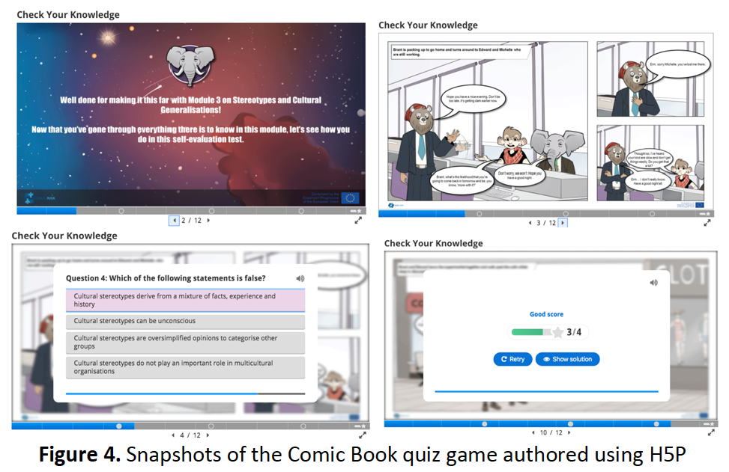
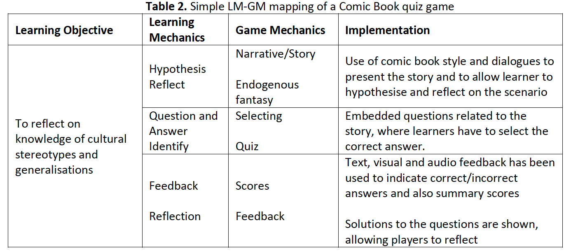
Learning-Game Mechanics Mapping Example

Slide 12



71 students at the Private University in Radom, Poland, who were undertaking a module on ‘Social aspects of the integration process in Europe’ (a response to the Covid-19 pandemic)
• How engaging are the interactive media, such as mini-games?
• Do these mini-games support the specific learning objectives and topics?
• Do you think that they can be used separately as a learning resource?
• Which are the top three mini-games that are both engaging and educational?
96% found the interactive media to be highly engaging,
100% found the games to be connected to the learning objectives (41% rated it high),
93% of the students stated that the mini-games can be used separately as stand-alone learning resources,
Notes:
96% found the interactive media to be highly engaging,
100% found the games to be connected to the learning objectives,
41% rated them highly
93% of the students stated that the mini-games can be used separately as stand-alone learning resources, which indicates the versatility
of the modular approach in populating the online platform with micro- learning activities.

Slide 13

Interactivity is key
Simplicity (yet with a level of challenge)
Drag and Drop for ‘what is culture’ in module 1- most votes as top (no 1).
Comic-book for check your knowledge segment in Module 8– second highest number of overall votes for top (no. 1).
Length is important (need more study)
Video-based not voted in top 3 – perhaps lengthier and will require more time investment
Notes:
Module 1 what is culture drag and drop first game discovered of this kind- hence perhaps the novelty – highest number of votes as first choice, And animated target and
Comic based in check your knowledge in module 8 – received second highest in votes for top 1. Still value in non-linear approach in comic based.

Slide 14




Thank You!
Prof. Sylvester Arnab
@sarnab75
sylvesterarnab.com
Notes:
shameless plug lol
A recently published book on intentional and purposeful teaching and learning that is taking inspirations from play and game-based research.
Again, thank you very much for having me. I hope that it has been insighful.
Thank you.

